Slide 1
Drilling Electronics Failure Risk and Lifetime Prediction (ELP) & Condition based Maintenance

Slide 2
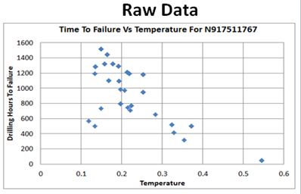

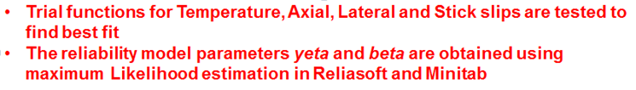
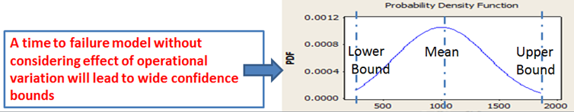
Reliability Model

Slide 3
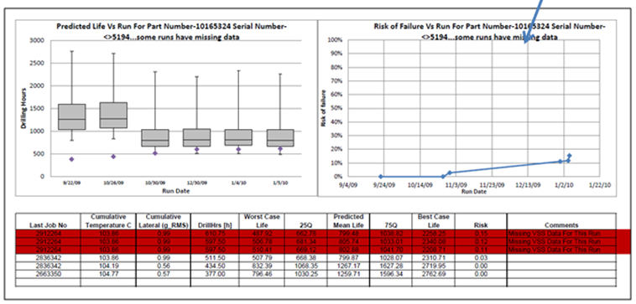
Prediction Result

Slide 4
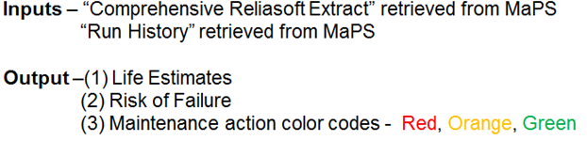
CBM Tools

